Slide 1
Simple Arrays
Short introduction to processing data
Notes:
1

Slide 2
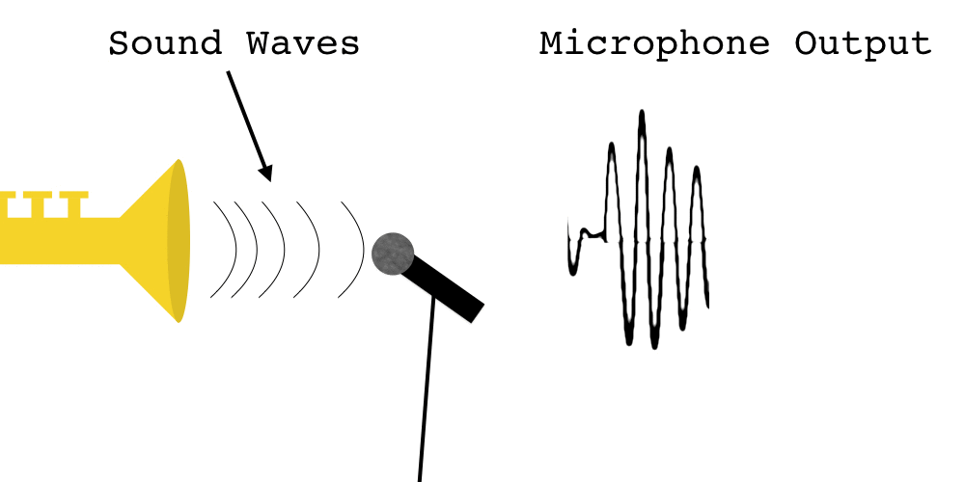
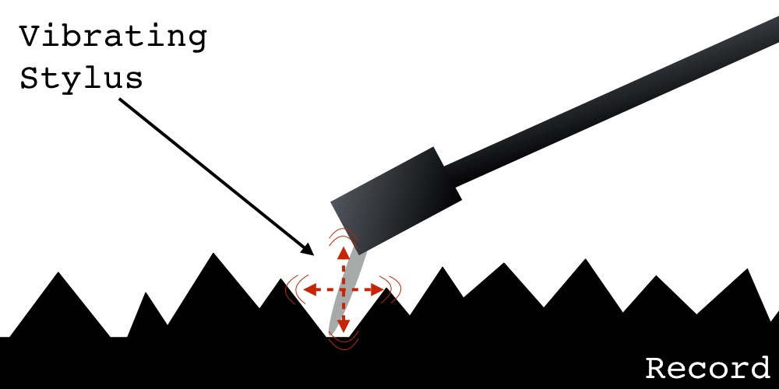
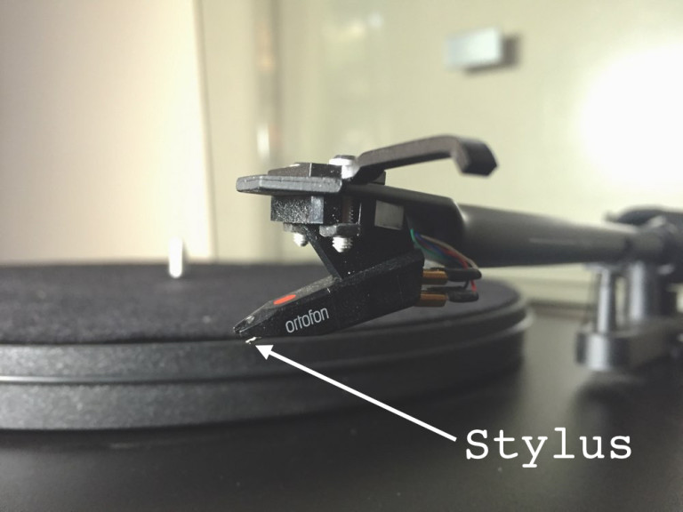
Recording and storing sound
Analog
http://www.soundsetal.com/blog-how-do-vinyl-records-work/

Slide 3
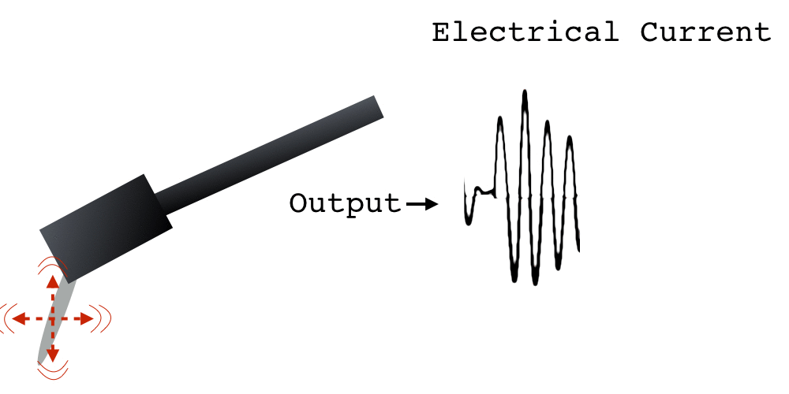
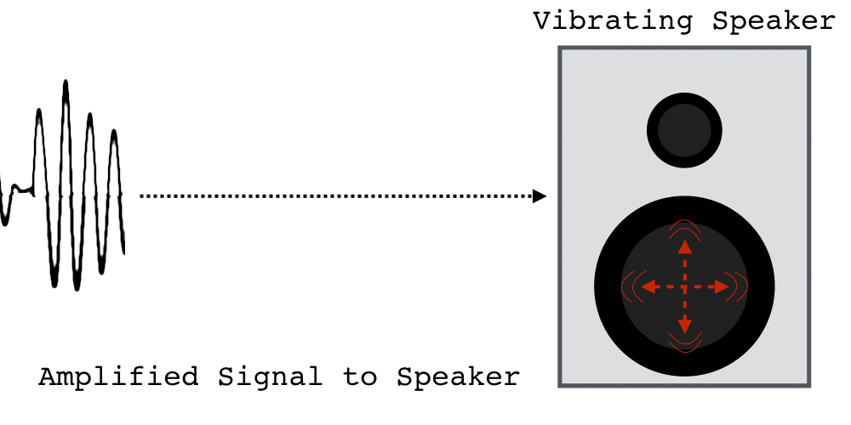
Playback of stored analog sound
Power Amplification

Slide 4
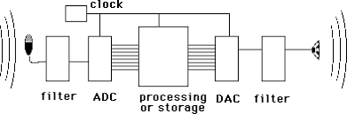
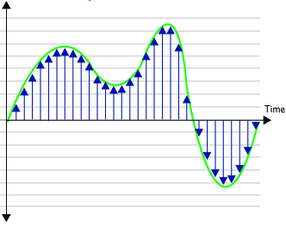
What about digital?
Sampling:
Audio CD quality
44100 samples/second
Quantization:
representing real values with fixed precision:
Audio CD quality
2¹⁶ possible distinct values
Array
5
15
32
38
42
41
40
37
35
0
0
27
…
0
1
2
3
4
5
6
7
8
9
…

Slide 5
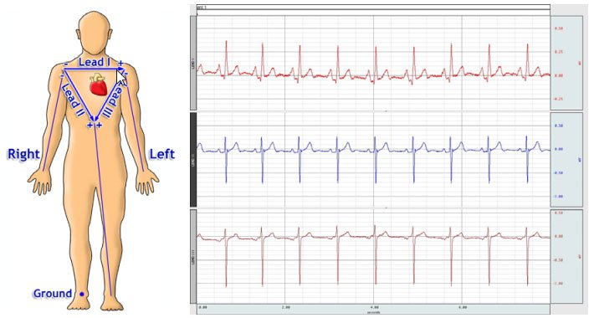
Biological signals
In computer memory, represented as array of data points/measurements

Slide 6
Representing images
! The order of data is as important as
the values themselves
Notes:
6

Slide 7
Declaring an Array Variable
type[] name = new type[n];
int[] intArray = new int[10];
intArray
0
0
0
0
0
0
0
0
0
0
0
1
2
3
4
5
6
7
8
9

Slide 8
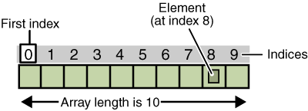
Arrays: Basic properties
1.
An array is ordered.(considering indexes not the contents)
2.
An array is homogeneous.

Slide 9
Array Selection
You can, for example, select the initial element by writing
intArray[0]
Assigning a value to an element
intArray[9] = 42;
intArray
0
0
0
0
0
0
0
0
0
0
42
0
1
2
3
4
5
6
7
8
9

Slide 10
Cycling through Array Elements
Cycling through each of the array elements
for (int i = 0; i < array.length; i++) {
Operations involving the i^{th} element of the array
}
As an example, you can reset every element in intArray to -1 using the following for loop:
for (int i = 0; i < intArray.length; i++) {
intArray[i] = -1;
}

Slide 11
An array of graphical objects

Slide 12
Let’s start by placing an array of cars
private final int CAR_WIDTH=75;
private final int X_OFFSET=50;
public void run(){
int numCars=10;
double carHeight=getHeight()/(2*numCars);
GRect[] cars=new GRect[numCars];
for(int i=0;i<numCars;i++){
cars[i]=new GRect(CAR_WIDTH,carHeight);
cars[i].setColor(rgen.nextColor());
cars[i].setFilled(true);
add(cars[i],X_OFFSET,(2*i)*carHeight);
}
}

Slide 13
Animating an array of objects

Slide 14
Initializing Arrays
Java makes it easy to initialize the elements of an array as part of a declaration. The syntax is
type[] name = { elements };
For example, the following declaration initializes the variable powersOfTen to the values 10⁰, 10¹, 10², 10³, and 10⁴:
int[] powersOfTen = { 1, 10, 100, 1000, 10000 };
This declaration creates an integer array of length 5 and initializes the elements as specified.

Slide 15
Lyrics generator: Anatolian rock

Slide 16
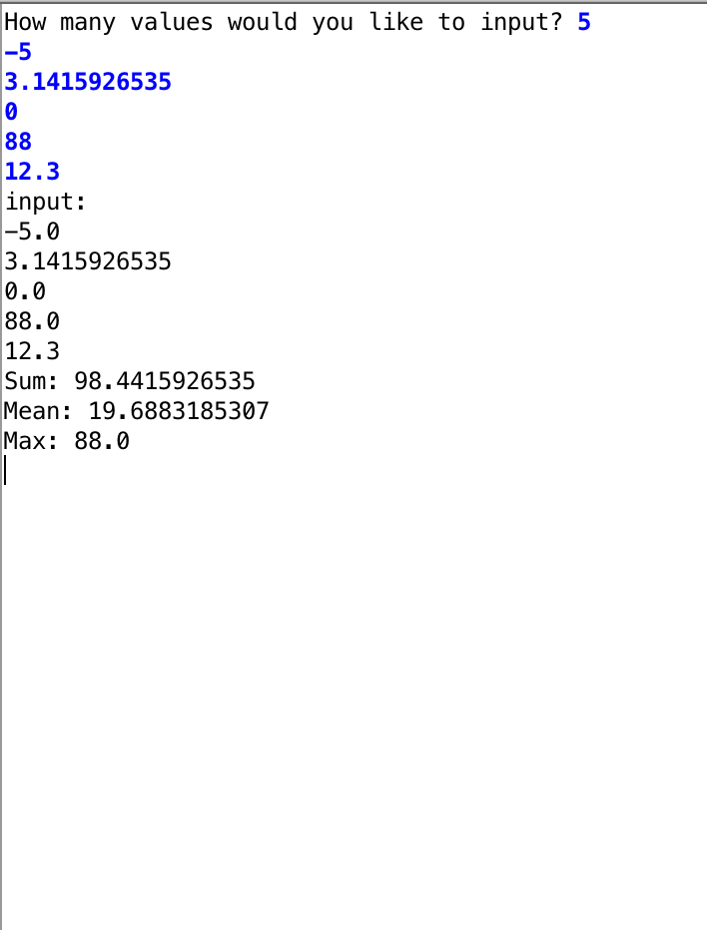
Exercise: Finding minimum, maximum and mean of an array of integers
Notes:
CODE ArrayExamples
Cmd + ‘+’ to zoom

Slide 17
Exercise: Finding minimum, maximum and mean of an array of integers
public void run() {
int numValues=readInt("Number of values to be entered: ");
/*Creating the array*/
int[] values=new int[numValues];
for(int i=0;i<values.length;i++) {
values[i]=readInt("Specify input for index "+i+" :");
}
println("Max: "+findMax(values));
println("Min: "+findMin(values));
println("Mean: "+findMean(values));
}
private int findMax(int[] inputArray) {
int max=0;
/*Implement the method*/
return max;
}

Slide 18
Review: methods
public class MethodsReview extends ConsoleProgram{
public void run() {
printInfo();
}
private void printInfo( ) {
println("This method prints some instructions");
println("1-Don't use arguments ");
println("...");
}
}
You should call the method to make use of it
This method does not take any input
This method does not return any output

Slide 19
Review: methods
public void run() {
int x = sum2ints(5,6);
}
private int sum2ints(int x,int y) {
int sum = x + y;
return sum;
}
You should call the method with two int inputs
This method takes two int inputs
This method returns an int output

Slide 20
What is the value printed?
public class MethodsReview extends ConsoleProgram{
private int var1=0;
public void run() {
someMethod();
println(var1);
}
private void someMethod(){
int var1 = 5;
}
}

Slide 21
What is the value printed?
public class MethodsReview extends ConsoleProgram{
private int var1=0;
public void run() {
someMethod();
println(var1);
}
private void someMethod(){
var1 = 5;
}
}

Slide 22
What is the value printed?
public class MethodsReview extends ConsoleProgram{
private int var1=0;
public void run() {
someMethod();
println(var1);
}
private int someMethod(){
int var1 = 5;
return 10;
}
}

Slide 23
What is the value printed?
public class MethodsReview extends ConsoleProgram{
private int var1=0;
public void run() {
var1=someMethod();
println(var1);
}
private int someMethod(){
return 10;
}
}

